Slide 1

Computing Engine for Sorting Algorithms
S131173 Mizutani Seiya
S131179 Iwata Narikatsu
S1310210 Tojo Rikuto

Slide 2
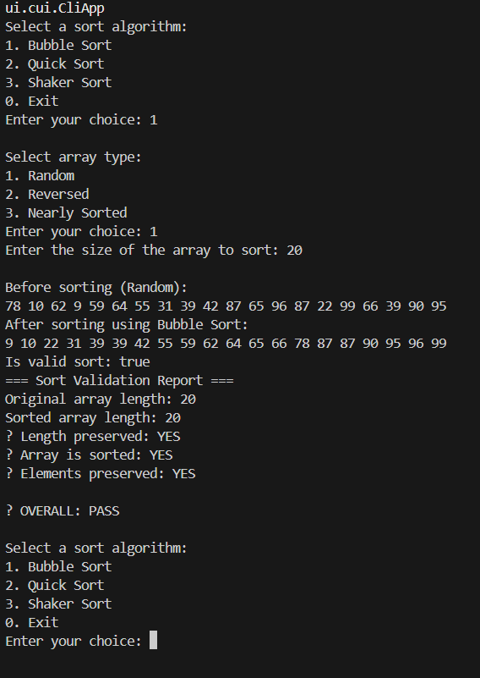
CUI

Slide 3
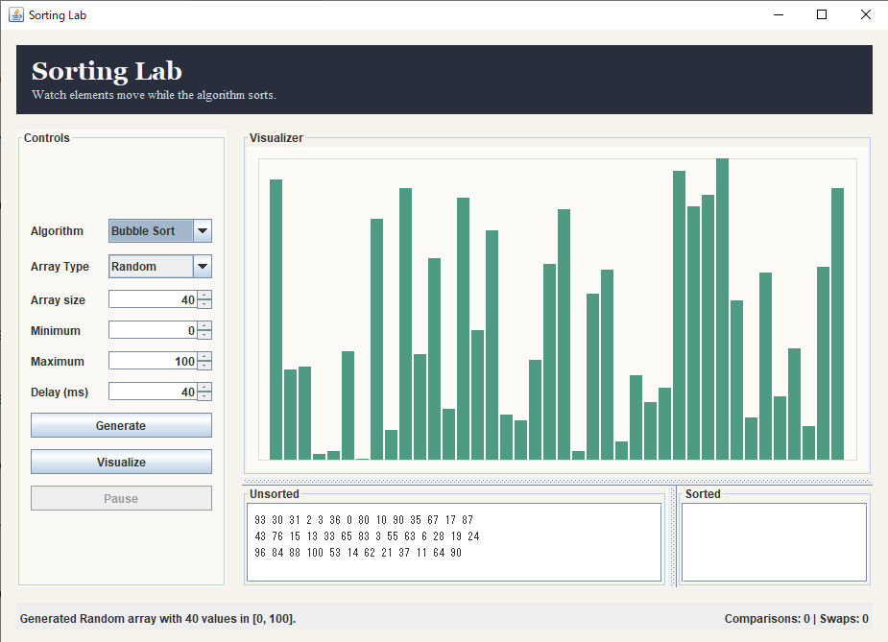
GUI

Slide 4
Thank you for your attention!

